Slide 1
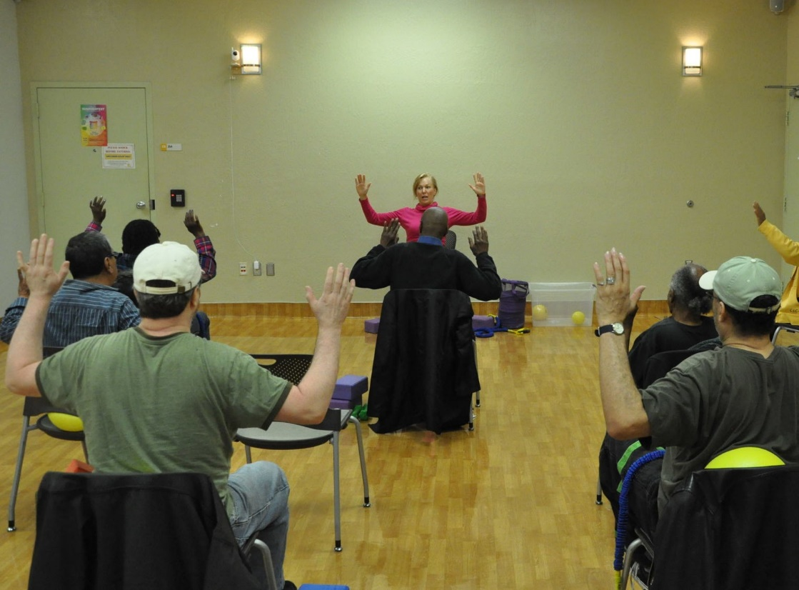
Evaluation of the implementation of a comprehensive HIV and aging program in a large urban HIV clinic: The Golden Compass Program
Meredith Greene MD, Janet Myers PhD, MPH, Judy Y. Tan PHD, Cinthia Blat, MPH, Allison O’Hollaren MHA, Francisco Quintanilla BS, Priscilla Hsue MD, Mary Shiels RN, Mary Lawrence Hicks FNP, William Olson, MS, Janet Grochowski PharmD, Jon Oskarsson RN MN, Diane Havlir MD, Monica Gandhi MD MPH
University of California San Francisco, San Francisco, California , United States
OBJECTIVE
To evaluate the initial implementation of an HIV and aging program, known as Golden Compass from January 2017-June 2018 using the implementation science framework Reach-Effectiveness-Adoption-Implementation-Maintenance (RE-AIM)
BACKGROUND
Globally the number of older adults living with HIV is increasing; in the US, 50% of all PLWH are age 50 and older
Older adults living with HIV have an increased risk of comorbidities such as cardiovascular disease and osteoporosis and experience geriatric conditions like falls and functional impairment at relatively younger ages
Many older adults living with HIV also face psychosocial issues such as social isolation
HIV care models should adapt to address the needs of older adults
PROGRAM DESCRIPTION
Ward 86 is a Ryan White and public health funded clinic on the campus of San Francisco General Hospital which serves approximately 2600 people living with HIV
The Golden Compass Program was developed from input from patients and providers at Ward 86 and services are conceptualized around the Four Points of a compass (see Figure 1)
In the program design, patients retain their primary care physicians; geriatric and cardiology specialists are on site at Ward 86
Older adults at Ward 86 could participate in 1 or more program components
METHODS
Initial implementation (First 1.5 years) focused on establishing group classes including exercise and brain health classes, bimonthly cardiology clinics and weekly geriatrics clinics at Ward 86
To evaluate the implementation, we used the RE-AIM framework
Reach: number/demographics of participants (patient level analysis)
Effectiveness: patient and provider acceptability with services and satisfaction with services (patient & provider level)
Adoption: number of provider referrals (provider level)
Implementation: fidelity to what was originally planned
Maintenance domain will be evaluated later
Data sources for RE-AIM domains included tracking referrals, surveys and qualitative interviews with patients and providers
RESULTS
Effectiveness:
In interviews medication support, mobility and cognitive assessments were valued
Patients were satisfied with classes (93% satisfied with brain health classes;100% exercise classes) and noted that classes facilitated new social connections:
“….helped me a lot because there’s a social aspect to it, I get to meet other people that are just like me, and that, I think, is very healthy, to connect to other individuals that are going through the same things that I'm going through.”
Adoption:
85% of providers referred ≥1
patient to geriatrics clinic
59% of providers referred ≥1
patient to cardiology clinic
Implementation:
Program was implemented largely as originally proposed
Co-location of consultant services an important aspect of implementation from qualitative interviews:
“I wish I can have all of my appointments here… I'm familiar with the building. When I [have to] go somewhere else, I still show up but it's just more far away and it's different, so I got to plan my timing and stuff. The area, the closeness, it's a plus.”
For additional qualitative results, see Poster # PEB0357
CONCLUSIONS
The Golden Compass program at Ward 86 is one of the first HIV and aging programs in the U.S. and evaluation of its success via implementation science methodology showed moderate reach, but high effectiveness, adoption, and implementation.
Next steps for Golden Compass include expanding the reach of the program and examining longer-term outcomes.
Come Visit Ward 86 in the Global Village: Ward 86: The HIV/AIDS Clinic at Zuckerberg San Francisco General Hospital AND as a co-organizer of Networking Zone: Celebrating the Resilience and Wisdom of Long-Term Survivors (LTS) and Elders with HIV: a Community Building Networking Zone for LTS, Elders and Allies
Figure 1
RESULTS
Evaluation summary by RE-AIM components:
Reach: 198 participants in 1.5 years (Table 1).In interviews, challenges with framing “aging services” was a barrier to reach
Effectiveness:
>90% of patients and providers were satisfied with the overall Golden Compass Program
>93% of patients and providers were satisfied with geriatrics clinic
>94% of patients and providers were satisfied with cardiology clinic
90% of providers felt the program improved care for older PLWH
The Golden Compass program had 96% acceptability as measured by “Would you recommend the program to someone else?”
Photo from “Wellness Club” exercise class
Table 1. Demographics of Golden Compass Program Participants n=198
Age in years (Mean, SD) | 62 (7.6 )
Race White Black Asian American Indian/Alaska Native Other | 78 (39%) 43 (22%) 14 (7%) 10 (5%) 33 (17%)
Latinx | 31 (17%)
Male Sex | 178 (89%)
CD4 T- cell count (cell/mL), (Median, IQR) | 514 (368-734)
Undetectable viral load (<40 copies/mL) | 171 (91%)
PRESENTED AT THE 23RD INTERNATIONAL AIDS CONFERENCE (AIDS 2020) | 6-10 JULY 2020
Questions? Contact Meredith Greene: meredith.greene@ucsf.edu

